Slide 1
Physics 220

Slide 2
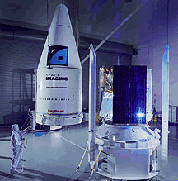


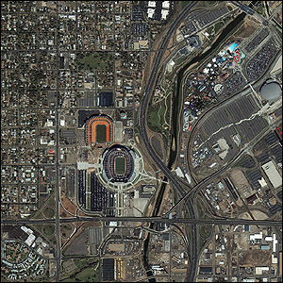

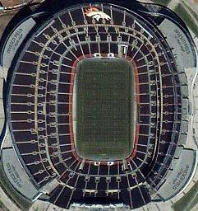
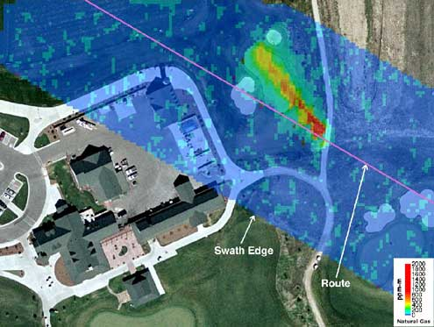
Instructor Introduction
R. Todd Lines
Education
BS Physics – BYU
MS, PhD Physics – NMSU
Recent Experience
7 years at BYUI
6 years with ITT (Eastman Kodak)
Laser radar
Atmospheric physics
Remote sensing
4 years experience with Raytheon
Weather satellite design
6 years experience with the US Army Research Laboratory
Atmospheric physics
Remote sensing

Slide 3
Course Description
Third Semester of Physics
Electricity and Magnetism (Classical model)

Slide 4
Survey Results:
Majer
Physics
Biochemistry
Chemistry
Computer science/Engineering
Civil engineering
Electrical engineering

Slide 5
Survey Results:
What do you hope to learn from this course?
“I have no idea,” was popular
“Laws of the natural world”
“how physics is applied to mechanical engineering”
What do you hope to do with this new knowledge?
Most said they wanted to apply what they learn in Engineering.
“I hope to use the new knowledge in my work field. “
“With this knowledge, I hope to apply it better to my own understanding of the world and it's machines.”

Slide 6
Survey Results
What do you expect the lectures to do for you?
Most wanted the lectures to answer questions and clarify concepts
This is in keeping with the Learning Model
Some wanted the lectures to be the primary learning vehicle
Sometimes this will be true, but sometimes it will not
I will try to strike a balance
Learning to read is important—no professors in industry

Slide 7
Survey Results
What do you expect the book to do for you?
Answers varied
Most said the book would be a source for learning the concepts we will study.
help me understand the material better
Give be a general idea of principles we are learning and help me identify things i don't understand.
Allow me to practice what I have learned through applicable exercises

Slide 8
Reading
Some Studies show reading can be important
Studies in 1990’s showed that in introductory physics courses…”
30% of students read the book
30% of students pass the course
The studies showed that the book is most helpful if read in advance of lecture and homework
Think of an English class, could you discuss and understand Hamlet without reading it?
I wanted to capitalize on this gain.
I want every advantage we can get!
Post graduate learning is mostly from books working on your own.
How to do this?
We picked the best, most easy to read book we could find! (but it weights to much)
Quizzes will be given to help remind you to read – they will not be concept questions, just test whether or not you did the reading.

Slide 9
Survey Results
How many hours a week do you think it will take to learn all you need to know from this course?
Answers varied from 6 to infinity.
Average was about 12
I hope that it will be no more than 15
We meet 5 days a week and you expect two hours out of class for every hour in class = 15 hours
It takes time and effort to grow new neurological connections that support these new skills
I want you to tell me how we are doing.
If you feel the load is too heavy
If you feel the load is too light
It will take some cooperation to make sure we neither kill you off nor send you to your jobs unprepared.

Slide 10
Course Objectives
The primary objective of this course is to help you develop a conceptual understanding of the fundamental physical principles described above.
The second objective of this course is for you to develop the mathematical description of these principles that can then be used to develop devices, structures, and technologies that are useful for mankind.
The third objective of the course is to help you use the mathematical description of these principles to develop problem solving skills that will benefit your future career.

Slide 11
General Philosophy of the Course
Physics is a topic that must be learned by faith, that is, by action.
You will need to read the text and perform the homework assignments in order to succeed in this course.
Studies have indicated there is value of reading the text but principally if the text is read before the lecture
Makes the semester less frustrating, more enjoyable

Slide 12
Learning Model Implementation
Teach One Another
Class Discussion
Prepare
Reading Assignment
Ponder/Prove
Daily Quiz, homework

Slide 13
Learning Model Implementation
Discuss
Discuss
Discuss
Read
Read
Read
Exam
Quiz
Quiz
Quiz

Slide 14
Learning Model Implementation
Final

Slide 15
Class Policies
We will follow the BYU-Idaho Honor Code in this class. In addition I would like to stress the following:
I expect professional behavior. Where I see unprofessional behavior, I will point it out so you get a good idea of what will be expected in your future jobs.
Plagiarism is a violation of the Honor code and will be grounds for a failing grade in this course. It may also cause other disciplinary action. If you use the work of another person (including a solution manual), you must give credit for that work. This is a rule that transcends college. It will be important in your future careers to establish intellectual property rights and to avoid law suits.
Cheating in any form, including claiming you made observations that you really didn't, is a gross violation of the honor code and most corporate values systems. Learning such behavior in school can lead to practices that would cause job termination, or even loss of life later in your career, so we will adhere to strict standards now.
Please do not discuss examinations administered in the testing center until the testing period has closed.
Please come to class on time
Complete the reading assignments before the lecture
Late assignments are highly discouraged. Late assignments are penalized 50% of their value for each class period past the due date
Learning the subject is the responsibility of each student. I will try in every way I can to facilitate the learning process. Please see me during my office hours or arrange a time with me to get extra help. I will assign you to work in groups and strongly recommend that you work together. (But be sure that the work you turn in is your own).
I will not post grades on Blackboard. Instead, I will periodically email your scores to your BYU-I account. You should check your grades to make sure I have recorded everything correctly.
Read the Syllabus

Slide 16
Procedures
Time in Class and Content: We will spend 60 minutes each day in class. Four days a week (MTWF) will be lecture days. Thursday is called a “recitation day.” We will use to do homework problems as groups.
We will not normally cover all the material in the chapter (derivations, example problems, etc.) You should come prepared to discuss this material. By “prepared” I mean that you should read the chapter sections assigned in the book before class starts. This is hard and takes some getting used to.

Slide 17
Procedures
Class attendance: It is very important that you attend class if you expect to keep up with assignments, examination preparation, etc. You will not see me taking roll, but I will always know from the clicker system if you are not attending class. I tend to “give the benefit of the doubt” (in terms of exam grading and final grades) to those students who faithfully attend class. If you must miss class for an interview or other BYU-I approved activity, please let me know in advance. You will be responsible for all information given as announcements in class whether you are there or not, so if you must miss, talk to me or to a trusted colleague to find out what happened in class.

Slide 18
Grading (1 of 2)
The class grade will consist of the following elements: daily quizzes, 12 homework assignments, 3 exams, a final exam, and a class presentation. The final grade will be based on the following (approximate) weighting.
Homework Assignments | 15%
Workbook Assignments | 10%
Quizzes | 5%
Exam #1 | 14%
Exam #2 | 14%
Exam #3 | 14%
Exam #4 | 14%
Exam #5 | 14%
Notes:
Final will be comprehensive
The third test is to not make the final so long

Slide 19
Grading (2 of 2)
There is no pre-assigned quota of A’s and C’s that will be given in the class. My personal goal is to give each of you all you need to earn an A. But it would not be beneficial to you if I artificially gave high grades. Level of effort and understanding of course material are two important factors to me in assigning letter grades.
94-100 | A |  | 73-77 | C
90-94 | A- |  | 70-73 | C-
87-90 | B+ |  | 67-70 | D+
83-87 | B |  | 63-67 | D
80-83 | B- |  | 60-63 | D-
77-80 | C+ |  | 0-60 | F
Letter grades will be assigned to the percentages of the final total score as shown in the table

Slide 20
Homework
Between 6 and 11 problems (sometimes more, sometimes less) will be assigned from each chapter.
We will also complete the Workbook sections that go with the text sections we have read.
Homework will be due on Tewsdays. I will try to not assign a problem until we have had a chance to talk about the material in class. Because of the holiday schedule, this sometimes makes the problem load uneven from assignment to assignment. You will know in advance what problems are assigned, and should plan time for the larger assignments.
You will not always be able to finish the homework assignments in the hour a week of non-lecture time we have on Thursdays. To make best use of this time, I suggest you look at the problems before the class homework sessions, and come prepared with questions. If you will miss a Tuesday or Thursday class, please let me know in advance.
You will turn in all of the homework problems. Neatness, organization, and use of the homework problem solving process will be part of the grade.
The homework problems are posted on I-Learn

Slide 21
Solution Manuals
I am aware that there are solution manuals available through the physics tutors, the library, the internet (usually illegally) and from book sellers.
I have copies of these solution manuals as well.
To copy a solution from the manual without noting that you have done so is to commit plagiarism. Since this is a violation of the Honor Code, please do not do this.
Also note that the homework process requires much more than is provided in the solutions given by the authors. If you limit your solution to what is in the manual, the best you could hope for is half credit.
Consistently using the manual’s solutions will not prepare you for the exams, and will likely lead to a very poor understanding of the material and an unfortunate grade.
If you are stuck on a problem, then consulting a manual might be a reasonable use of a solution manual, but be sure to form your own solution. Consulting a physics tutor or talking to me might be even better.

Slide 22
Examinations
The exam questions will stress problem solving.
A typical exam will consist of ten problems Half of which will be conceptual, half like homework problems
As with the homework, the method used is as important as a correct answer.
Partial credit will be given based on the correctness of the method used.
The same problem solving process used for homework should be used on the exam questions.
Notes:
I reserve the right to adjust the value of the test to make up for extra hard tests
No extra penalty
I will not adjust the value of the test to make up for extra easy tests
Again, no extra penalty
Student has missed out on a fair assessment of their performance

Slide 23
Teaching Method
Active class
Emphasis on concepts on lecture days
Emphasis on problem solving on homework days
Notes:
If you have trouble with this style of lecture, please let me know
This is in keeping with direction from President Clark

Slide 24
Disclaimer for Today’s Demonstrations
If the humidity is high, we will be in trouble
The fact that humidity is important is fascinating
If the humidity is high, we will consider why humidity is important as an extra credit problem! – so we will be OK either way.

Slide 25
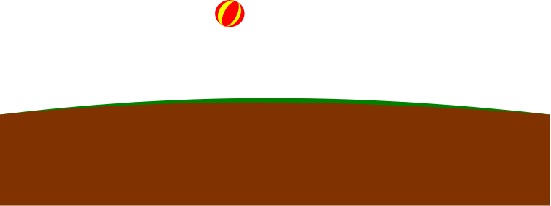
a
v

Slide 26
-
-
-
-
-
-
-
-
-
-
-
-
-
-
-
-
-
-
-
-
-
-
-
-
-
-
-
-
-
-
-
-
-
-
-
-
-
-
-
-
-
-
-
-

Slide 27
+
+
+
+
+
+
+
+
+
+
+
+
+
+
+
+
+
+
+
+
+
+
+
+
+
+
+
+
+
+
+
+
+
+
+
+
+
+
+
+

Slide 28
-
-
-
-
-
-
-
-
-
+
+
+
+
+
-
-
-
-
-
+
+
+
+
+
-
-
-
-
-
-
-
-
+
+
+
+
+
+
+
+
+
+

Slide 29
-
-
-
-
-
-
-
-
-
+
-
-
-
-
-
-
+
-
-
-
-
-
-
-
-
-
-
+
+
-

Slide 30
-
-
-
-
-
-
-
-
-
-
-
+
+
-
-
-
-
-
-
-
-
-
-
-
-
-
Nucleus
+
+
-
-

Slide 31
+
-

Slide 32
+
-
-
-
-
-
-
-
-
-
-
-
-
-
-
-
-
-
-
-
-
-
-
-
+
-
-
-
-
-
-
-
-
-
-
-
-
-
-
-
-
-
-
-
-
-
-
-

Slide 33
+
-
+
+
+
+
+
+
+
+
+
+
+
+
+
+
+
+
+
+
+
+

Slide 34
+
-
+
-
-
-
-
-
-
+
-
-
-
-
-
-
-
-
-
+
-
-
-
-
-
-
+
-
+
-
-
-
-
-
+
-
+
-
+
-
+
+
-
-
+
-
+
-

Slide 35
+
-
-
-
+
+
+
+
+
-
+
-
-
-
-
+
-
+
-
+
-
+
-
+
+
-
+
-
+
-
+
-
+
-
-
+
-
+
-
-
-
-
-
-
-
-
+
-
-
-
-
-
-
-
-
+
+
+
+
-
-
-
-
-
-
-
-
+
-
-
-
+
+
+
+
+
-
-
-
-
-
-
-
-
-
+
-
-
-
+
+
+
+
+
+
+
-
-
+
+
-
-
-
-
-
-
-
-
-
-
-
-
-
-
-
-
+
+
+
+
-
-
-
-
-
-
-
+
-
-
-
+
+
-
-
-
-
-
-
-
-
-
-
-
+
+
+
-
-
+
+
+
-
+
+
+
+
+
-
-
+
-
-
+
+
-
+
-
+
-
+
+
+
+
+
+
+
-
+
+
+
+
+
+
+
+
+

Slide 36
+
-
+
+
+
+
-
+
-
-
-
-
-
+
-
+
-
+
-
+
-
+
-
+
+
-
+
-
+
-
+
-
+
-
-
-
+
-
+
-
-
-
-
-
-
-
+
-
-
-
-
-
-
-
-
-
+
+
+
+
-
-
-
-
-
-
-
+
-
-
-
+
+
-
-
-
-
-
-
-
-
-
+
-
+
+
-
+
-
+
+
+
+
+
+
+
-
-
+
-
-
-
-
-
+
-
+
-
-
-
-
-
-
-
-
-
+
+
-
-
-
-
-
-
-
+
-
+
+
-
+
-
-
+
+
+
+
+
-
-
-
-
-
-
+
-
-
+
-
-
-
-
-
+
-
-
-
-
-
-
-
-
-

Slide 38
Electrons
+
Electron
Nucleus with protons and neutrons
Particles not drawn to scale

Slide 39
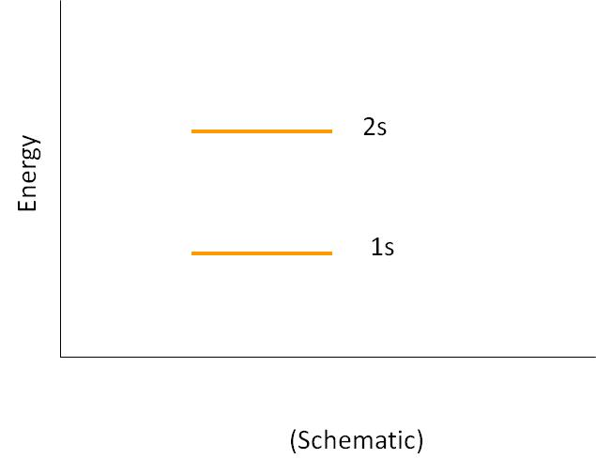
Energy Levels in Atoms
2s
Energy
1s
(Schematic)

Slide 40
Bringing Two Atoms Together
2s
Energy
1s
Distance, r
(Schematic)

Slide 41
Bringing 5 Atoms Together
2s
Energy
1s
Distance, r
(Schematic)

Slide 42
Many Atoms Together (A Solid)
2s
Energy
1s
Distance, r
(Schematic)

Slide 43
Many Atoms Together (A Solid)
2s
Energy
1s
r_{o}
Distance, r
(Schematic)

Slide 44
Energy Bands, Detail
Sodium example
Blue represents energy bands occupied by the sodium electrons when the atoms are in their ground states
Gold represents energy bands that are empty
White represents energy gaps
Electrons can have any energy within the allowed bands
Electrons cannot have energies in the gaps
3p
3s
2p
2s
1s

Slide 45
Energy Level Definitions
The valence band is the highest filled band
The conduction band is the next higher empty band
The energy gap has an energy, E_{g}, equal to the difference in energy between the top of the valence band and the bottom of the conduction band

Slide 46
Conductors
When a voltage is applied to a conductor, the electrons accelerate and gain energy
In quantum terms, electron energies increase if there are a high number of unoccupied energy levels for the electron to jump to
For example, it takes very little energy for electrons to jump from the partially filled to one of the nearby empty states

Slide 47
Insulators
The valence band is completely full of electrons
A large band gap separates the valence and conduction bands
A large amount of energy is needed for an electron to be able to jump from the valence to the conduction band
The minimum required energy is E_{g}
Conduction Band
Energy Gap, E_{g}
Valance Band

Slide 48
Semiconductors
A semiconductor has a small energy gap
Thermally excited electrons have enough energy to cross the band gap
The resistivity of semiconductors decreases with increases in temperature
The white area in the valence band represents holes
Conduction Band
Energy Gap, E_{g}
Valance Band

Slide 49
Insulator Conductor

Slide 50
-
-

Slide 51
TurboBlowTM
^{Blow Dryer}
The third wire in electrical devices is connect to the ground

Slide 52
+
-
+
-
-
-
-
-
-
+
-
-
-
-
-
-
-
-
-
+
-
-
-
-
-
-
+
-
+
-
-
-
-
-
+
-
+
-
+
-
+
+
-
-
+
-
+
-

Slide 53
-
-
-
-
-
-
-
-
-
-
-
+
+
-
-
-
-
-
-
-
-
-
-
-
-
-
Nucleus
+
+
-
-

Slide 54
Center of Negative Charge
-
-
Center of Positive Charge
+
+ + +
+
-
-

Slide 55
Center of Negative Charge
Center of Positive Charge

Slide 56
Center of Negative Charge
Center of Positive Charge

Slide 58
+
+
-
-
+
-
+
-
+
-
+
+
-
-
+
+
-
-
+
-
+
-
+
-

Slide 59
+ + + +
- - - -
+ + + + + +
- - - - - -
+ + + + + + +
- - - - - - -
+ + + + + + + +
- - - - - - - -
+ + + + + + +
- - - - - - -
+ + + + + +
- - - - - -
+ + + +
- - - -

Slide 60
Comparison to Gravity

